Slide 1

US-Accidents Data Analysis
Group – 8
Poornima Pulakandam
Joseph Antony Bala Vineesh Reddy Pentareddy
Ivy Pham
Srujana Patil

Slide 2
Introduction
Road accidents have become very common these days. Nearly 1.25 million people die in road crashes each year, on average, 3,287 deaths a day. Moreover, 20–50 million people are injured or disabled annually. In the USA, over 37,000 people die in road crashes each year, and 2.35 million are injured or disabled.
Looking at the severity of road accidents, we decided to analyze the accidents’ data by Exploratory Data Analysis (EDA). It applies various statistical methods to a data set and observes the data's main characteristics. This often includes data visualization techniques to picturize the numbers found during exploration.

Slide 3
Dataset Description
US-Accidents dataset is a countrywide traffic accident dataset, which covers 49 states of the United States. The data is continuously being collected from February 2016 to March 2019, using several data providers, including two APIs which provide streaming traffic event data.
The dataset contains 2,243,939(2.24 million) rows and 49 columns(Quite a large dataset). A point to be noted is that even though the dataset contains data for only three years, there are 2.24 million accidents already.

Slide 4
Approach
Downloading the data: The first step to any data project is to download the data. In this case, the CSV file is directly accessed from Kaggle.
Data Preparation: After getting hold of the data, the following steps are needed to make it ready for data analysis and visualization-
Load the file using Pandas.
Look at preliminary information or summary statistics.
Fix any missing/incorrect values.
Data Analysis and Visualization: Once the data is cleaned and prepped for analysis, we take some of the columns and apply statistical methods to see the underlying picture come to the surface.

Slide 5
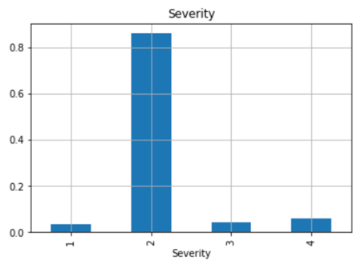
Exploratory Data Analysis
Most of the US Accidents i.e 0.8 have the severity 2 and followed by severity 4.

Slide 6
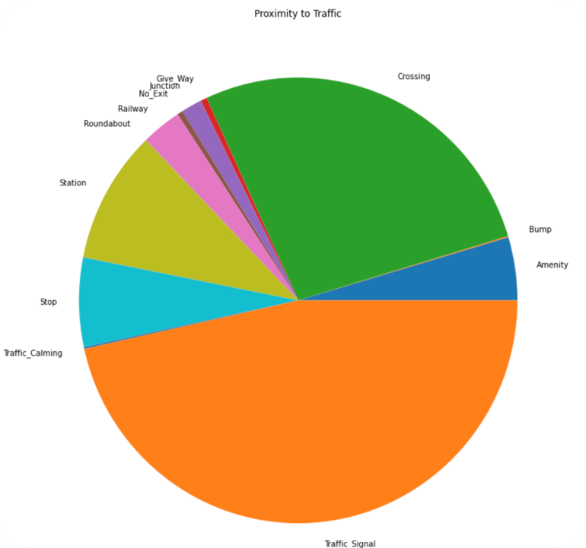
Exploratory Data Analysis
Major percentage of the US Accidents are occured at traffic signals, Crossing, Station, Stop and Amenity.
The least percentage of accidents are occured at Bump, Roundabout, Railway, No-Exit, Junction

Slide 7
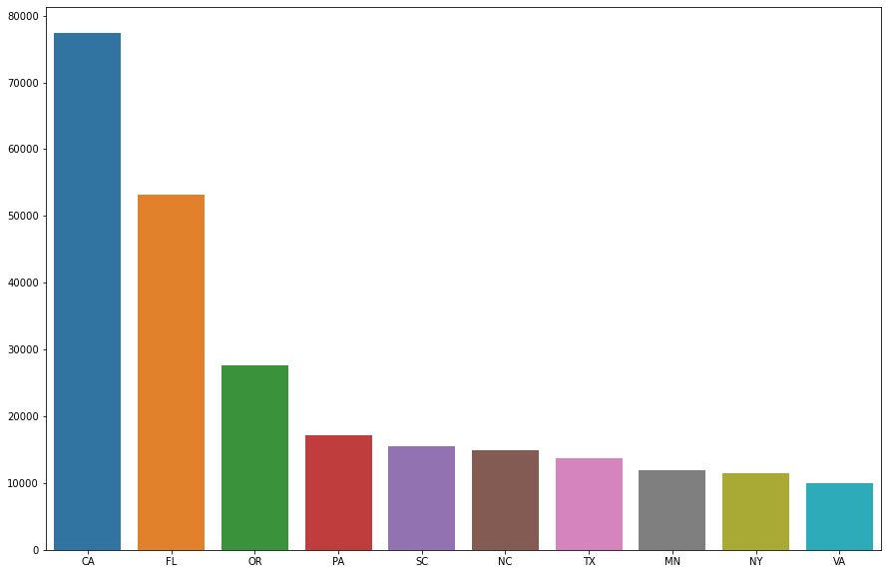
Exploratory Data Analysis
We have analysed Most percentage of accidents are occured in California followed by florida.

Slide 8
Exploratory Data Analysis
We have analysed the state-wise accidents data in USA.
Most percentage of accidents are occured in California followed by florida.

Slide 9
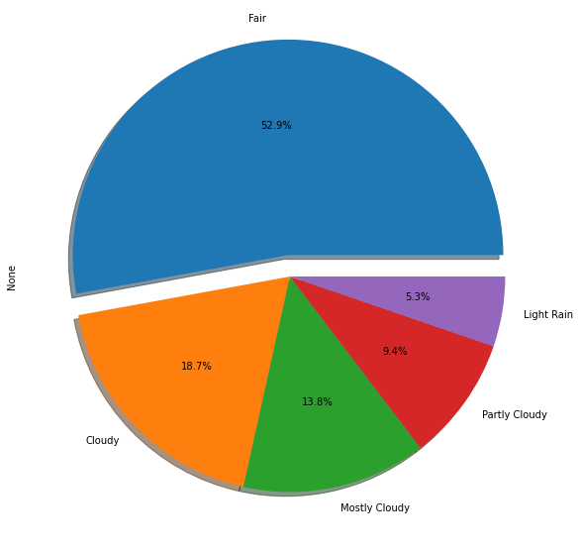
Exploratory Data Analysis
Accidents are occurred in clear weather conditions(52.9%) and followed by cloudy weather 18.7% which means that weather conditions effects very less.

Slide 10
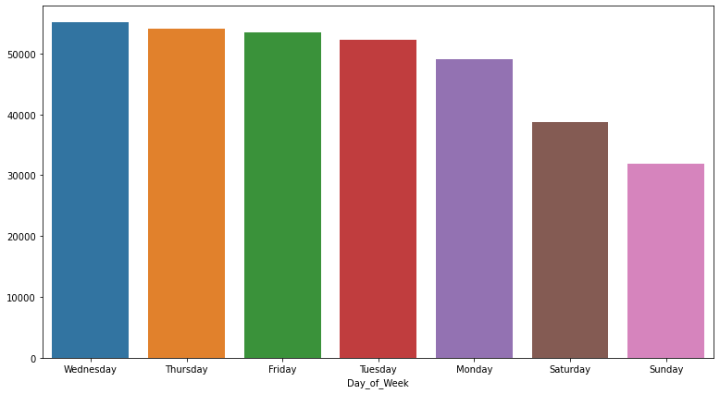
Exploratory Data Analysis
Weekday Accidents are higher in number compared to weekends.

Slide 11
Data Modeling and Evaluation
we have used K-Nearest Neighbour, Logistic Regression, Decision Tree for Data Modeling.
The evaluation methods used are Accuracy Score, Precision Recall, Cross Validation Score.

Slide 12
Results
A state's population has an obvious effect on the numbers. However, many other factors can also affect these rates, including types of vehicles driven, travel speeds, rates of licensure, state traffic laws, emergency care capabilities, etc.
Generally, major percentage of the US Accidents were occurred at traffic signals, crossing, station, stop and amenity. Weather doesn’t seem to have big impact on numbers of accidents since more than half happened in fair condition. There are more accidents happened during weekdays compares to weekend days as people have to get on the roads to work.
From the data, we found California is the state with highest number of accidents follows closely by Florida. Los Angeles county contributed the largest number of accidents in California, more than 3 times the number of accidents in Kern, the second most accidents in this state.

Slide 13
Future Scope
Analyze year-on-year trends of accidents.
Explore per-capita accident figures by adding a state and city-wise population data set.
The question of missing data in certain months could be analyzed if there is some data available on the source/s of this one.

Slide 14
Conclusion
In conclusion, it can be said that while the percentage of accidents is low for most cities, it is important to hammer the point that this analysis points to the following-
The majority of such accidents seemed to have happened due to the absence of proper traffic management mechanisms like traffic signals and bumps- particularly in areas away from the main crossings.

Slide 15
THANK YOU

